Slide 1
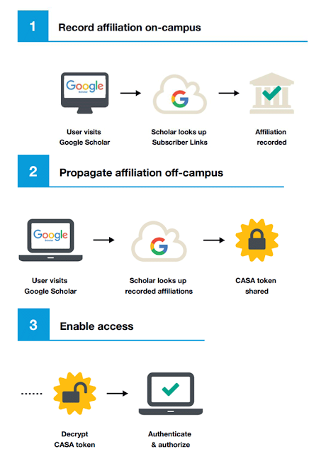
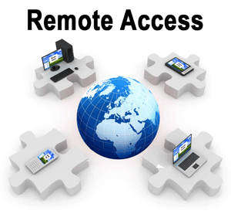
Google Scholar CASA
“Campus Activated Subscriber Access”
O V E R V I E W
CASA is an authentication enhancement that improves the authentication for off-campus users of Google Scholar.
It builds on Google Scholar's Subscriber Links program which provides direct links in the search interface to subscribed collections for on-campus users.
No action / cost required from libraries to enable.
No action required from users to enable.
Provides 90 day token for access IEEE Xplore remotely.
S T E P S
Visit Google Scholar while on-campus or connect to campus network using VPN/remote access systems provided by your Library.
Find an IEEE article through Google Scholar and click the link to IEEE Xplore.
Google Scholar records an affiliation between your device (laptop, mobile phone, desktop, etc.) and your institution.
1

